Slide 1

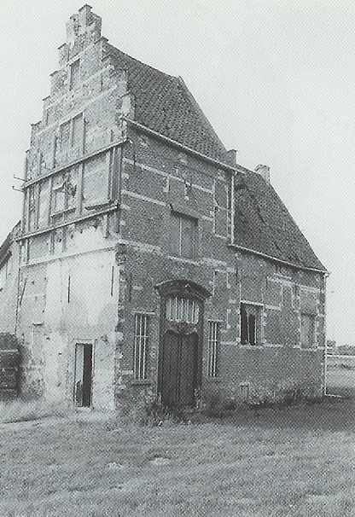
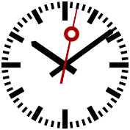



90min
CODE COMPLETE
Part 2
Theoretical
Introduction
ArchitectureTrack

Slide 2


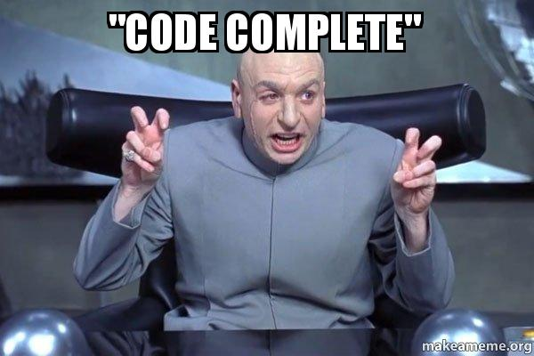

what does it even mean
Notes:
“Code Complete” (from the “Software release life cycle”)
A release candidate is called code complete when the dev team agrees no entirely new source code will be added to it.
So still room for config, data changes, bugfixes etc – but no show-stopping bugs have been discovered during testing.

Slide 3
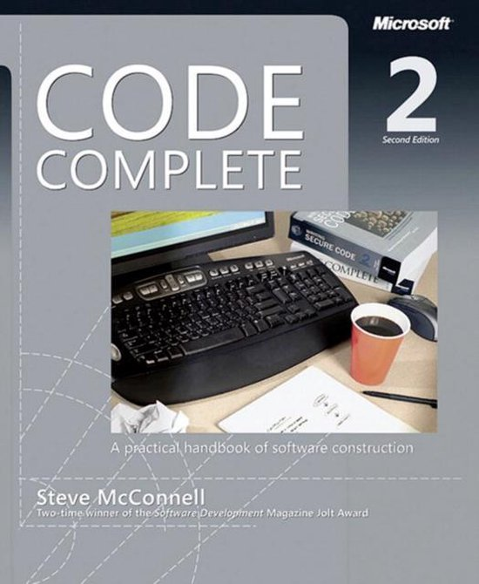
Code Complete?
Steve McConnell (1993 / 2004)
Microsoft Press
960 Pages 😱
Summary course: 8 hours
Backed with data from studies
…
We will have to be a bit more brief
And still end up with slides with copious amounts of text

Slide 4





The Coding Horror blog got its logo from Code Complete.
Notes:
https://blog.codinghorror.com/
Jeff Atwood (StackOverflow)

Slide 5

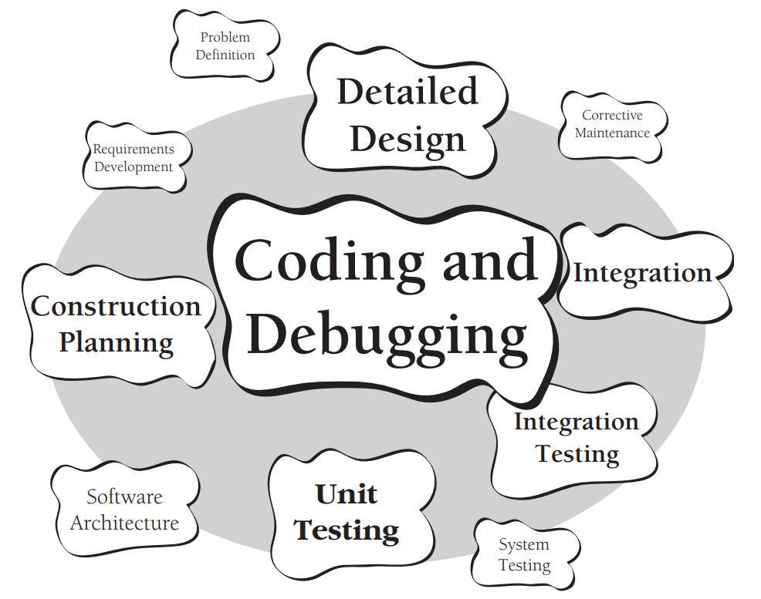
Code Complete
Book focus
30 to 80% of total time spent on the project
Often the only accurate description of the software
Construction: the only activity that’s guaranteed to be done

Slide 6
Code Complete
A practical handbook of software construction
7 Chapters
Laying the Foundation
Creating High-Quality Code
Variables
Statements
Code Improvements
System Considerations
Software Craftsmanship

Slide 7


Recap
Part 1

Slide 8

Software Development
Business systems tend to benefit from highly iterative approaches in which planning, requirements and architecture are interleaved with construction, system testing and qa.
Notes:
It can be beneficial to be more sequential when
Fairly stable requirements
The team is familiar with domain and client
Low risk projects

Slide 9


Key Points
The Myth of Stable Requirements
Good architecture makes construction easy
BDUF to NDUF to LDUF and ENUF
Notes:
Stable Requirements:
The more business, customers and the development team work on a project, the better they understand their own needs
This is a major source of requirement changes.
Good Architecture
Bad architecture can make construction almost impossible
Requirement changes are 20 to 100 times as expensive in the stages following construction
Big Design Up Front, No Design, Little Design and Enough Design

Slide 10
Design
“emergent” and “heuristic”
Design evolves and improves through design reviews, informal discussions, experience writing the code itself, and experience revising the code.
Strive for minimal complexity,
Ease of maintenance and
Iterate, iterate, and iterate again.
Notes:
Heuristic:
A heuristic, or heuristic technique, is any approach to problem solving or self-discovery that employs a practical method that is not guaranteed to be optimal, perfect, or rational, but is nevertheless sufficient for reaching an immediate, short-term goal or approximation.
Maintenance: 75% to 90% of all work is maintenance. Most likely changes should cause the system the least trauma.

Slide 11
Classes
Work in the problem domain rather than in the low-level implementation domain
If a class is not making your job simpler,
it’s not doing its job
Containment (“has a”) is the work-horse technique in OO. Beware of inheritance.
Notes:
Beware of inheritance
It certainly has its uses.
But like avoid deep hierarchies!

Slide 12
Routines
The theoretical best max length is often described as one screen or 1-2 pages: approximately 50 to 200 lines
Complexity
1 point for each if/else/case, while/repeat/for, and/or
Score
0-5 Probably fine
6-10 Emerging refactor candidate
10+ Time to break it up
Notes:
TDD advocates etc often aim for routines of 10-30 lines

Slide 13

PART V
Code
Improvements
Notes:
Recap Part 1: also lots of information on Exceptions, variable naming, Booleans, etc. Check out the pptx or video!

Slide 14

The Software Quality Landscape

Slide 15
The General Principle of Software Quality
Improving quality reduces development cost
Software defect removal is the most expensive and time-consuming form of work
It’s cheaper to build high-quality software than it is to build and fix low-quality software
Notes:
Reduces the development cost:
More expensive in the beginning. The cost reduction is over the total project lifetime.
Maintenance takes up to 80% of total project budget.

Slide 16
The Software-Quality Landscape
Conflicting Software Quality Characteristics
External characteristics – what the user cares about
Usability, Reliability, Robustness, Efficiency, …
Internal characteristics – what only the team cares about
Maintainability, Testability, Reusability, …

Slide 17
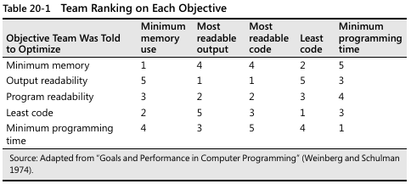
The Software-Quality Landscape
Conflicting Software Quality Characteristics
Set explicit quality objectives
and developers will follow them

Slide 18
Have a Software Quality Plan
Set explicit & reasonable quality goals
Explicit: focus on goals (software characteristics)
Communicate: the team must be aware
Automatic: CI quality gatekeepers
Measured: evaluate how we’re doing

Slide 19

Collaborative Construction

Slide 20
Collaborative Development Practices
Part of a comprehensive quality program
Different error-detection techniques find different types of errors
They complement testing practices
Developers have different ‘blind spots’

Slide 21
Pair Programming
Why
Keep quality high even when under stress
Improve code quality
Shorten schedules (at the end of the project)
Mentoring of junior programmers
Foster collective ownership

Slide 22
Pair Programming
Keys to success with pair programming
Prerequisite: coding standards
Don’t let it turn into watching
Don’t use it for the easy stuff
Rotate pairs often
Don’t pair people that dislike each other
Avoid pairing two newbies
Pairs should match pace

Slide 23
Formal Inspections
Read all new code in a meeting with 3+
Planning
Overview
Preparation
Inspection Meeting (all logic is explained – all branches)
Inspection Report
Rework
Follow-Up
Third-Hour Meeting (optional)
Notes:
Planning: Certified Moderator sets up the meeting
Overview: extra context from the Author
Inspection Meeting: max 2 hours
Inspection Report: email with issues found (by Scribe)
Third-Hour Meeting: Discuss possible solutions

Slide 24
Formal Inspections
catch about 60% of all defects relatively economical compared to testing
Checklist with past problems
Focus on detection, not correction
Reviewers arrive with a list of problems they’ve discovered
The (Trained) Moderator is not the Author
The Scribe (not Moderator/Author) creates the tickets
Data is collected and fed into the checklist
Only technical team members attend

Slide 25
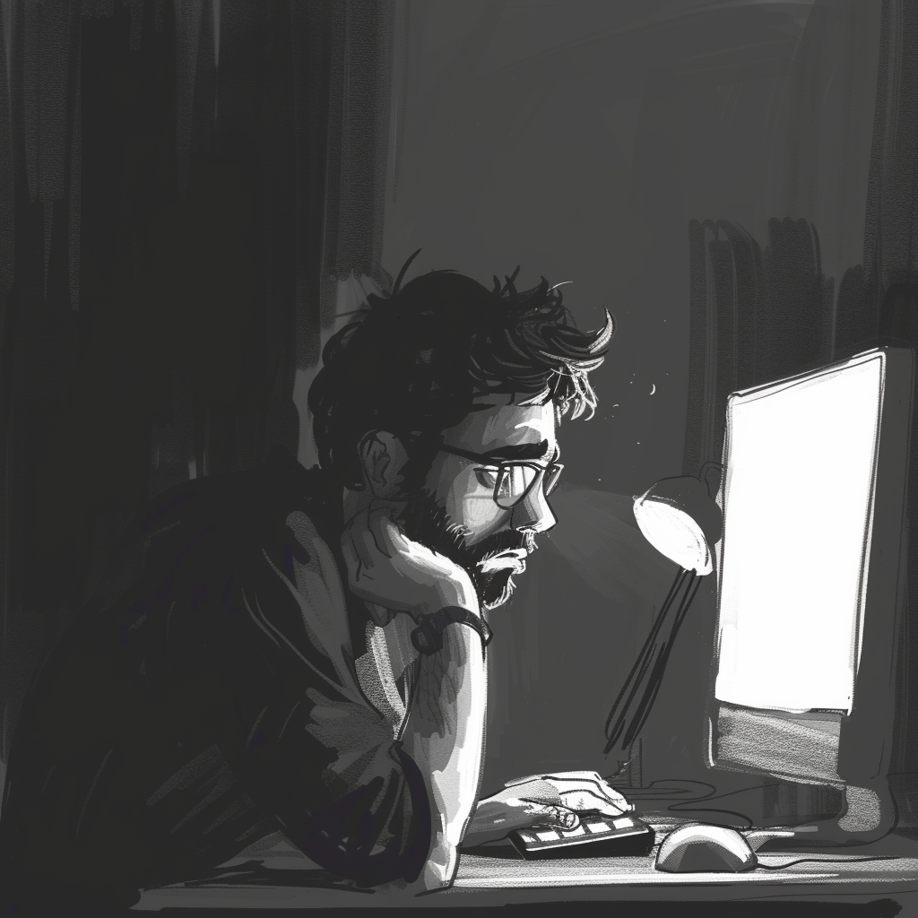
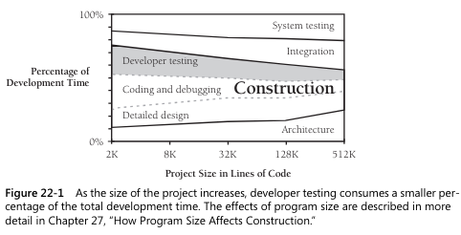
Developer
Testing

Slide 26



Unit Tests
Test-First or Test-Last
Clean tests vs Dirty tests
Testing how the code breaks (25 to 1 ratio)
Branch coverage
Control-Flow vs Data-Flow Testing
Equivalence Partitioning – don’t test the same thing twice
Boundary Analysis – off by one errors
Compatibility with old data
Avoid impossible data – a negative amount of employees
A list of common errors – that happened in the past
Notes:
Test-First or Test-Last: McConnell: one of the most beneficial software practices to emerge during the past decade
Branch Coverages: all possible paths! 2 ifs → 4 tests minimum
Equivalence Partitioning:
an if has two equivalence classes: true/false
$1000 is as likely to reveal an error as $3594 but it is a lot easier to do a manual hand check with
List of common errors: Create a PR_Checklist.md?

Slide 27

Test Tools
Scaffolding
Test-Data Generators
Data Recorder / Logger
Replayer
Error Database

Slide 28

Break

Slide 29

Debugging

Slide 30

Defects as Opportunities
Learn about the program
Learn about the kinds of mistakes you make
Learn about your code quality from a reading perspective
Learn how you solve problems
Learn how you fix defects
Notes:
Kinds of mistakes you make → programmer “blind spots”!

Slide 31


Bug Hunting
Finding the bug == 90% of the work
Litter the code with debug statements
The Scientific Method
Gather data with experiments
Form a hypothesis
Experiment to prove / disprove
Repeat
Create Unit Tests to expose the defect
Use available tools
Notes:
Available Tools: Debugger, Profilers, Rubber-duck programming, run tests on save, memory checker, text comparer, git bisect …

Slide 32

Bug Hunting
Don’t be superstitious – select isn’t broken
Focus on the fix not the blame – it’s always your fault
Make up a list of things to try
Quick & dirty debugging – set a timer
Be suspicious of code that
Has recently been changed
Had defects before
Don’t trust line numbers in stack traces
Treat compiler warnings as errors
Notes:
select isn’t broken:
Pragmatic Programmers: it’s not the OS, or the compiler, the database, …
McConnell: 95% of errors reported are by programmers. 2% (compiler & OS), 2% by other software and 1% hardware.
Debugging by Superstition:
That one programmer that has endless problems with demon machines, compiler defects, hidden language defects that only appear when the moon is full

Slide 33

Bug Killing
Bugfix: 50% chance of being wrong
Make sure you understand the problem
Fix the problem, not the symptom
Use the most obvious fix
Look for similar errors elsewhere
Make one change at a time
Notes:
Defect corrections: understand the problem before you fix it

Slide 34
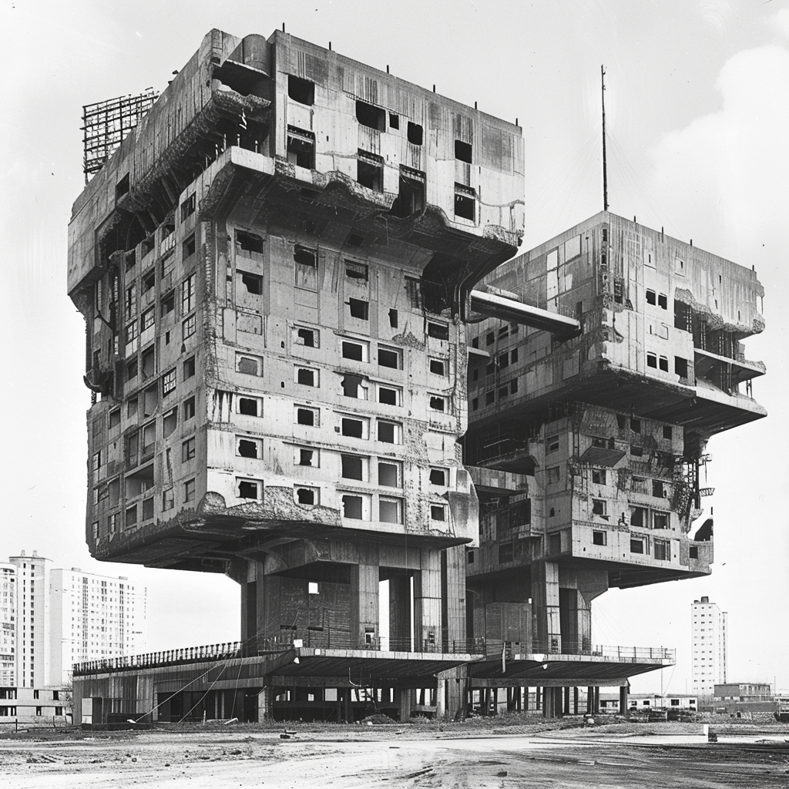
Refactoring

Slide 35
Refactoring
Reality: code evolves substantially during its initial development
Does program quality improve or degrade under modification?
Notes:
Changes should make future similar changes easier.

Slide 36

Refactoring: when
Duplicated code
Routine too long / too many params
Deep nesting
Poor naming
Changes require parallel modifications to classes
A class doesn’t do very much
Comments are used to explain difficult code
Notes:
More whens:
Class interface has different levels of abstraction
Interface hierarchies / case statements have to be modified in parallel
Related data that is used together is not in a class
A class is overly intimate with another (ex subclasses knowing too much about their parents)
Global variables
A routine has setup and/or teardown methods
Code that might be useful someday

Slide 37

Refactorings
Replace magic string/number
Replace code with a routine/class
Introduce an intermediate variable
Decompose Boolean expression(s)
Break up long lines
Split up multi-use variable
Convert constants to a class or enum
Replace conditionals with polymorphism
Pass the object rather than its fields

Slide 38

Refactorings
Adjust your approach depending on the size of the refactoring
Keep em small
One at a time
Commit often
Boy scout rule

Slide 39

Code-Tuning Strategies
measure twice, cut once

Slide 40

Code-Tuning
Refactorings that degrade the internal structure
The Pareto Principle applies
Old Wives’ Tales
Reducing lines of code improves speed
Certain operations are probably faster
You should optimize as you go
Notes:
Pareto: 20% of the code consumes 80% of execution time
Old Wives’ Tales
Reducing line count improves performance: unrolling a loop

Slide 41

Performance
Input/Output is expensive
Many aspects are counterintuitive
Experience doesn’t help much
Consider
Changing requirements
Upgrading hardware
Code-tuning as a last resort
Revert code-tunings that didn’t help

Slide 42

Performance
Cache calculations in a dictionary
Lazy evaluation or pre-compute
Unrolling & Loop Jamming
Nested Loops
Put the busiest loop on the inside
Recode in a low-level language
Notes:
Jamming: don’t loop the same collection twice

Slide 43

Performance
Strength Reduction
For i = 0 to saleCount - 1
commission(i) = (i + 1)
* revenue * baseCommission * discount
Next
incrCommission = revenue * baseCommission * discount
cumulCommission = incrCommission
For i = 0 to saleCount - 1
commission(i) = cumulCommission
cumulCommission = cumulCommission + incrCommission
Next

Slide 44

Break

Slide 45

PART VI
System Considerations

Slide 46
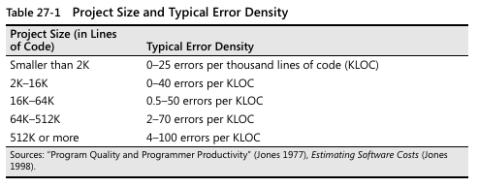
Project Size vs Error Density
Notes:
Project Size:
Communication between team members – Fred Brooks The Mythical Man-Month

Slide 47
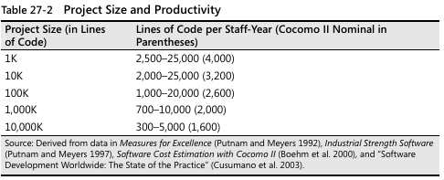
Project Size vs Productivity

Slide 48

Managing Construction

Slide 49

Estimation
Projects don’t make up lost time later, they fall further behind

Slide 50

Estimation
Spell out software requirements
Estimate at a low level of detail
Estimates include tasks from the QA Program
When falling behind
Expand the team
Reduce scope
Measure & Compare

Slide 51

Integration

Slide 52
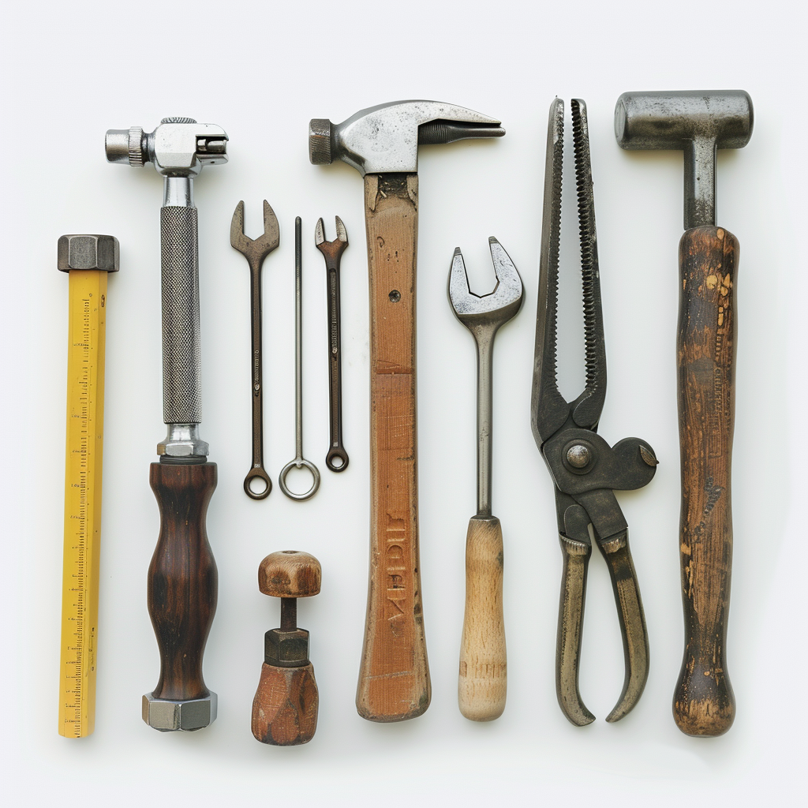
Programming Tools

Slide 53

Tools
Design Tools
IDE (refactorings)
Source Control, Diff & Merge
Code Beautifier
Templates
Picky Syntax Checker
Metric Reporters
Code Generation (Wizards)

Slide 54
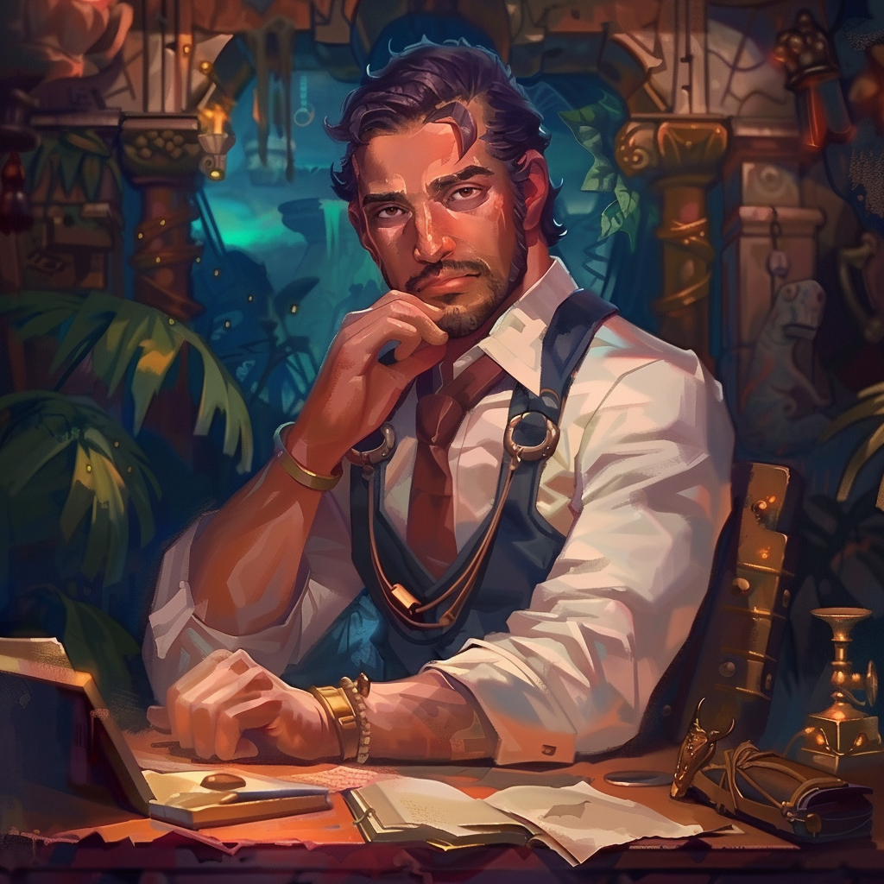
PART VII
Software Craftsmanship

Slide 55
Software Craftsmanship
Any fool can write code that a computer can understand. Good programmers write code that humans can understand – Martin Fowler

Slide 56

Code Layout
Layout as religion
Represent the logical structure of the code
Improves readability
Withstand modifications
Lines longer than 80 chars are hard to read
30+ pages of layout comparisons
Notes:
Withstand modifications: Should not have to reformat multiple lines after changing the name of a routine
80 chars: These days you can (well) beyond that

Slide 57
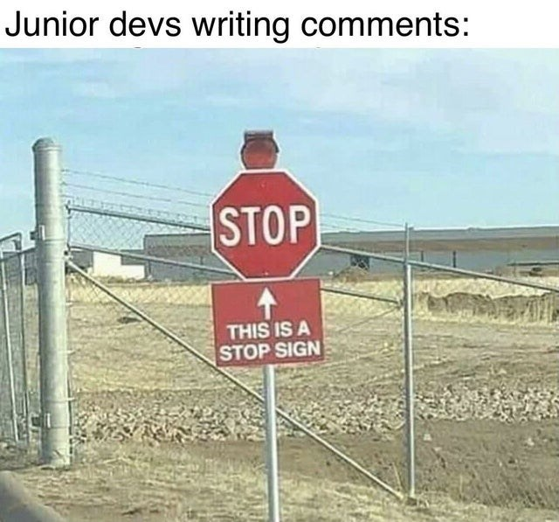
Comments
To Comment or Not to Comment

Slide 58

Comments
Can be damaging
Don’t repeat the code or explain it
Clarify intent
Explain at a higher level of abstraction
Information that cannot be expressed with code
Clarity peaks at 1 comment per 10 statements
Avoid endline comments
Notes:
Bad comments hurt more than that they help.

Slide 59
Comments
Write self-documenting code
Then add comments to make it even better
Don’t comment tricky code; rewrite it
Or do comment when that is not an option
Surprises
Workaround bug in a framework
Performance optimalization
JavaDoc: for virtually all routines

Slide 60

Personal Character

Slide 61

Personal Character
Great intelligence is only loosely connected to being a good programmer
The more humble, the faster you’ll improve
Curiosity
Communication and Cooperation
Creativity vs Discipline
Laziness
Notes:
Humble: If you already know everything, there is nothing to learn!
Curiosity: Read books, blog posts, experiment, learn about successful projects, …
Communication: Writing readable code is part of being a team player
Discipline: Establish conventions in non-critical areas so creativity is possible in the places that count
Laziness: write a tool to automate an unpleasant task

Slide 62
Intellectual Honesty
The first 90% of the code accounts for the first 90% of the development time. The remaining 10% of the code accounts for the other 90% of the development time. – Tom Cargill
Notes:
Readily admitting your mistakes
Providing realistic status reports & estimations

Slide 63
Themes
Managing Complexity
Process has significant effect on the final product
An exercise in communicating with people first, and computers a far second
Programming conventions can be a cure worse than the disease
Program in the problem domain
Dogmatic methodologies and high-quality software don’t mix

Slide 64


Slide 65



THANK YOU!

Slide 66
Resources
Online course (8h)
It’s not for everyone (book review)
More positive book review (see infographic-book-best-chapters.png)

Slide 67
WiFi: itenium-guest / Wifi4Ufree
New WiFi: ITENIUM_GAST / FreeWifi

